Slide 1

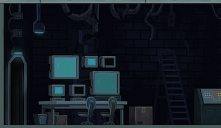


Monkey Goes Banana: Lab Escape Game
“Eat bananas, go *pew pew*, gain your freedom!”
Presented by :
David Shlaifer
Sofia De Palma
Kaci Luu
Mikhayla De-Las-Alas

Slide 2


Overview
Game inspiration
Super Mario – This game shares similarities with Super Mario through its use of power-ups that enhance gameplay,Both games feature level progression, with players advancing through progressively harder stages after defeating enemies, just like Mario moves through different maps.
Asteroids - This game has similarities to Asteroids in its fast-paced, shoot-and-dodge gameplay, where players must quickly eliminate enemies while avoiding obstacles. Both games emphasize dynamic action, with enemies (or asteroids) constantly moving and requiring the player to stay alert and responsive.
Metroid:- With Metroid, we liked the fact that it portrayed shooting enemies with a gun and that they would disappear (almost explode). We took that aspect and added it to our game as well.
This single-player shooter game, inspired by classic games like Asteroids and Super Mario Bros., as well as the film Rise of the Planet of the Apes, has players controlling a monkey who was experimented on in a lab. The objective is to navigate through the map, eliminating evil lab employees to face the final boss, the Evil Head Scientist. Along the way, players can collect power-ups: bananas for increased strength and lab vials for a higher firing rate. Defeating the final boss grants the monkey its freedom, displayed with a winning jungle scene, while getting caught shows a losing screen with the monkey behind bars.

Slide 3


Game inspiration
Super Mario – This game shares similarities with Super Mario through its use of power-ups that enhance gameplay. Both games feature level progression, with players advancing through progressively harder stages after defeating enemies, just like Mario moves through different maps.
Asteroids - This game has similarities to Asteroids in its fast-paced, shoot-and-dodge gameplay, where players must quickly eliminate enemies while avoiding obstacles. Both games emphasize dynamic action, with enemies (or asteroids) constantly moving and requiring the player to stay alert and responsive.
Metroid:- With Metroid, we liked the fact that it portrayed shooting enemies with a gun and that they would disappear (almost explode). We took that aspect and added it to our game as well.
Primate 194:
Main character (only playable character)
Baby monkey that had been captured to be experimented on
His role in the game:
- Shoot and eliminate all enemies he encounters at each level in order to move on to the next level
- Beat the Final Boss, retrieve the lab key and escape!

Slide 4


Characters of the Game
Evil Head Scientist (aka the Big Boss)
Main antagonist of the game; Primate 194's main enemy
Role in the game:
- serves as the Final Boss of our game
Primate 194:
Main character (only playable character)
Baby monkey that had been captured to be experimented on
His role in the game:
- Shoot and eliminate all enemies he encounters at each level in order to move on to the next level
- Beat the Final Boss, retrieve the lab key and escape!
Security Guards
Secondary enemy ; Evil Head Scientist's employees
Role in the game:
- Attempt to capture Primate 194 before he encouters the Evil Head Scientist

Slide 5





Characters of the Game
How to play the game?
Evil Head Scientist (aka the Big Boss)
Main antagonist of the game; Primate 194's main enemy
Role in the game:
- serves as the Final Boss of our game
Monkey :
Moves with arrows on the keyboard
Shoots by pressing “Space” button on the keyboard
Has 5 chances of surviving for each level
But has only 1 chance in the final level
Big Boss :
To kill him , shoot 15 times
Security:
- To kill them, shoot 2 times
Monkey Power Up Tools
Banana
Green liquid vial
Security Guards
Secondary enemy ; Evil Head Scientist's employees
Role in the game:
- Attempt to capture Primate 194 before he encouters the Evil Head Scientist

Slide 6
How to play the game?
Monkey :
Moves with arrows on the keyboard
Shoots by pressing “Space” button on the keyboard
Has 5 chances of surviving for each level
But has only 1 chance in the final level
Big Boss :
To kill him , shoot 15 times
Security:
- To kill them, shoot 2 times
Monkey Power Up Tools
Banana
Green liquid vial

Slide 7
How to play the game?
The levels explanation :
- Level 1: You start the game inside a small room in the lab where you encounter your first set of enemies, 3 security guards who are shooting tranquilizers at you! In order to progress, you must use your banana-shooting gun and eliminate all enemies.
- Level 2: You enter the next level as you walk into a slightly bigger room and encounter even more security guards eager to capture you. Eliminate them and move on to face the Final Boss.
- Final Level: For the final level, you come face to face with your main enemy, the Head Evil Scientist. Dodge his poisonous attacks at all costs and defeat him once and for all! Be careful, only 1 hit of his poison will end the game!
Win Scenario : If you manage to defeat the Head Evil Scientist, a key appears. The play must then collect the key in order to officially end the game. The winning screen rewards the player with the view of a very happy Primate 194 enjoying the taste of his newfound freedom!
Lose Scenario : If at any moment during the game, you get hit 5 times by a tranquilizer shot by a security guard, you unfortunately lose the game and end up back in your cell inside the lab. You will also lose and be recaptured if you are hit at any time by the Boss' poison bottles.

Slide 8
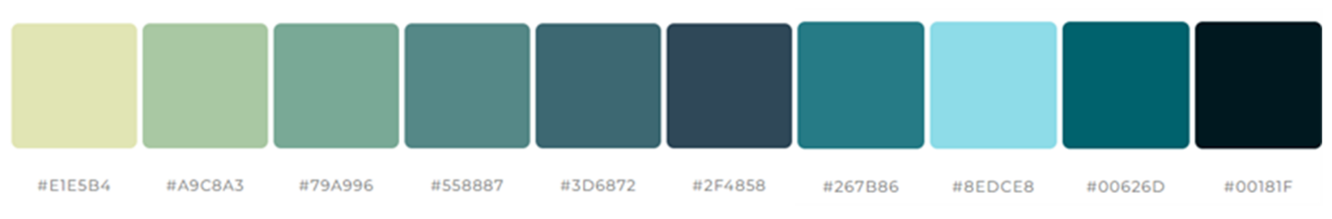
Art Direction
Pixel art
2D
Colour palette : black, blue, turquoise, green, yellow
A pixel art style that emphasizes a science laboratory in 2D
Top-down design

Slide 9


Contributions
Sofia: Monkey (both), power ups, shooting for the monkey, debugging
Mikhayla: Shooting and the little scientist, power ups
David: The big boss and home screen
Kaci: Transitions, video background, scientists, background display, debugging

Slide 10
Difficulties & What We Learned
Many firsts -> quite a bit of trial & error
Had a bit of difficulty implementing some elements as we are beginner programmers
Had a lot of bugs
Be creative, but also be realistic
Organization and time management should be a top priority
Good communication between teammates can make all the difference; so be sure to voice any and all opinions and be sure to keep an open mind when working with others
We learned to be careful with loops; we got a big bug at some point due to an infinite loop

